Slide 1
VKeyBoard
A project done by,
Abhishek K (715514106002)
Arjhun M (715514106007)
Vasigaran S (715514106057)
Arullanandh S (715514106008)
Guided by,
Dr. G. Santhanamari AP(Sl.G) / ECE

Slide 2
Objectives
To implement all functions of mechanical keyboards.
To increase portability.
To give a different perspective of laser keyboards.
To improve cost and performance.

Slide 3
LITERATURE SURVEY
SL.no | RESEARCH PAPER TITLE/ AUTHOR | METHODOLOGY | ISSUES TO BE ADDRESSED
1 | "Virtual keyboard: A human-computer interaction device based on laser and image processing"-Xiaolin Su,Yunzhou Zhang, Qingyang Zhao, Liang Gao | A CMOS image sensor is used to collect the sequential frames of fingertips keystroke. Every keystroke can be detected accurately by image processing including morphology principle and ellipse fitting | keystroke deviation, resulting in fitting center falling unexpected region.
2 | “Keystroke recognition for virtual keyboard”- J. Mantyjarvi, J. Koivumaki, P. Vuori | An infrared (IR) transceiver array is used for detecting the proximity of a finger. Keystroke recognition accuracy is examined with k-nearest neighbor (k-NN) classifier while a multilayer perceptron (MLP) classifier is designed for online implementation. | the finger had to be held perpendicular to the surface of the keyboard.
3 | "Visual panel: virtual mouse keyboard and 3D controller with an ordinary piece of paper", -Z. Zhang, Y. Wu, Y. Shan et al. | The panel tracking continuously determines the projective mapping between the panel at the current position and the display, which in turn maps the tip position to the corresponding position on the display. | The keystroke detection action is triggered when the tip pointer stays immobile for a short duration of 1 second.
4 | "An asynchronously controlled EEG-based virtual keyboard: improvement of the spelling rate”,-R. Scherer, G. R. Muller, C. Neuper et al. | an asynchronously controlled three-class brain-computer inter- face-based spelling device virtual keyboard, operated by spontaneous electroencephalogram and modulated by motor imagery. | asynchronous control can limit the usability of the system. Users do require more training

Slide 4
Problem Definition
  The current generation virtual keyboards do not use efficient gesture recognition algorithms.
  It does not support multiple touches.
  Laser keyboards cannot be used on rough and transparent surfaces.
  Surrounding lights also affects the keyboard display.

Slide 5
Proposed Virtual keyboard
  In the proposed keyboard, the laser diodes are placed in a matrix fashion and the laser lights are made to intersect at the respective rows and columns.
  The end point of these laser diodes is the light dependent resistors.
  When the light falls on the light dependent resistor (LDR), the voltage across LDR is more than 3 volts which is considered as logic ‘1’ (key detection is not identified).
  If the light energy from laser diode is blocked then the voltage across LDR will be less than 3 volts which is considered as logic ‘0’ (key detection is identified).
  When human hands are placed between laser light and LDR (intersection of the matrix) a respective key will be pressed and identified. In this way multiple keys can be mapped to the multiple intersections of the matrix.

Slide 6
Block Diagram
NI MyRio
Lasers
PROCESSOR
A
B
C
D
(0,0)
(0,1)
(0,2)
(0,3)
(1,0)
(1,1)
G
(1,2)
(1,3)
E
F
H
I
(2,0)
(2,1)
(2,2)
L
J
K
(1,1)
M
(3,0)
N
(3,1)
(3,2)
(3,3)
O
P
LDR
F
LCD display
INPUT DEVICE
OUTPUT DEVICE

Slide 7
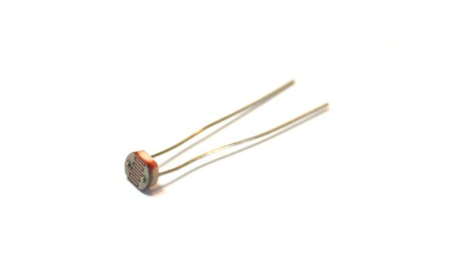
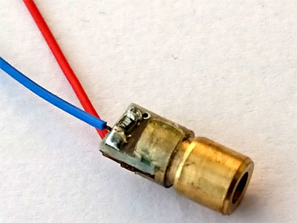
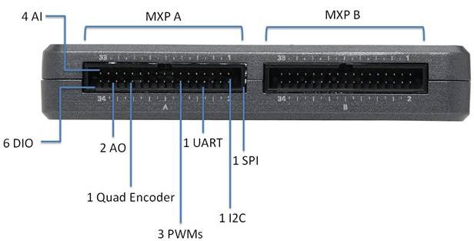
HARDWARE COMPONENTS
REES52 Red laser diodes 650nm
5mm Light Dependent Resistors
NI myRIO

Slide 8
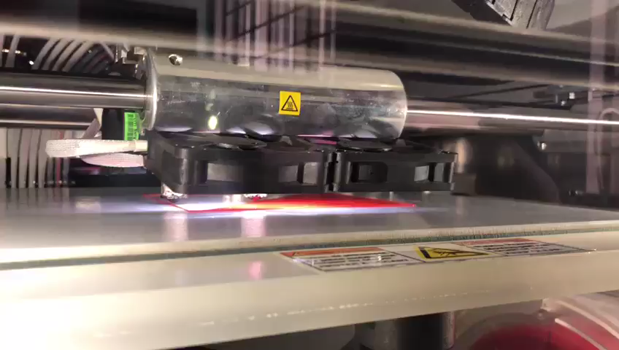
The keyboard module was built by 3d printing.
Stereolithography (STL) is one of the file types that is used for 3D printing.
The modelling material is Red Acrylonitrile butadiene styrene (ABS), an oil-based plastic.
ABS gives the product with better structural integrity and it is more suited to mechanical use given the material can better withstand the elements.

Slide 9
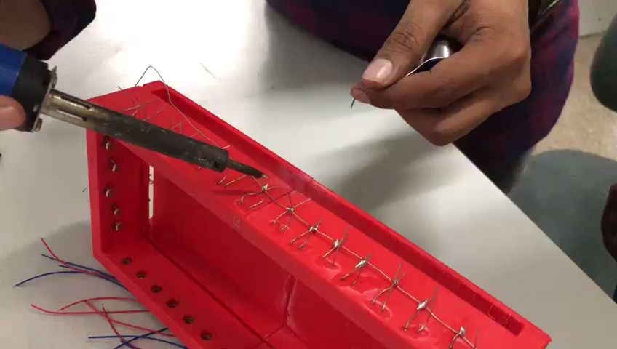
The model is cuboid in shape with one of the faces left open and the rest are covered.
There are 14 tiny holes on each of the two longer faces of the cuboid.
There are 5 similar holes on the each of the smaller faces of the cuboid.
The holes at the faces of the modelled material are to aid the insertion of lasers and LDR’s.
The position of the holes are precise such that the parallel holes are aligned in a straight line.

Slide 10

FINAL VIDEO LOG

Slide 11
Comparative study
Constraint | Existing method | Proposed method
Surface dependencies | Doesn't work on transparent and rough surface | Independent of surfaces
Surrounding light dependencies | Keyboard display does not work on bright lights | Independent of surrounding lights
Cost | Rs.10,000 (epic) to Rs.1,00,000 (xperia touch) | Not more than Rs.3500

Slide 12
Timeline of activities
Started on 14th december 2017
Problem statement: 20 december 2017(date of completion)
Design of project: 25th december 2017(date of completion)
Software: 31st december 2017(date of completion)
Hardware: 3rd january 2017(date of completion)
Beyond 11th january 2017 : Future Improvements. (Quality, Performance etc.)

Slide 13
REFERENCES
1. Xiaolin su,Yunzhou Zhang, Qingyang Zhao, Liang Gao
"Virtual keyboard: A human-computer interaction device based on laser and image processing"
Published in IEEE International Conference on Cyber Technology in Automation, Control, and Intelligent Systems (CYBER),Year: 2015
2. J. Mantyjarvi, J. Koivumaki, P. Vuori
“Keystroke recognition for virtual keyboard”
Published in IEEE International Conference on Multimedia and Expo
Year: 2002
3. Z. Zhang, Y. Wu, Y. Shan et al.,
"Visual panel: virtual mouse keyboard and 3D controller with an ordinary piece of paper",
Published in workshop on Perceptive user interfaces.
Year: 2001
4. Hari Singh Dhillon, Rajesh Singla, Navleen Singh Rekhi,
"EOG and EMG based virtual keyboard: A brain-computer interface"
Published in IEEE International Conference on Computer Science and Information Technology
Year: 2009
5. R. Scherer, G. R. Muller, C. Neuper et al.,
"An asynchronously controlled EEG-based virtual keyboard: improvement of the spelling rate",
Published in IEEE Transactions on Biomedical Engineering.
Year:2004

Slide 14
6. H. Du, T. Oggier, F. Lustenberger et al.,
"A virtual keyboard based on true-3D optical ranging", Published in British Machine Vision Conference, Year:2005
7. Huan Du,, Edardo Chardon
"A virtual keyboard system based on Multi-Level Feature Matching”
Published in Conference on Human System Interactions
Year: 2008
8. Hubert Cecotti
A Multimodal Gaze-Controlled Virtual Keyboard
Published in IEEE Transactions on Human-Machine Systems
Year: 2016
9. Katz I, Gabayan K, Aghajan H
"A Multi-Touch Surface Using Multiple Cameras”.
Dept. of Electrical Engineering, Stanford University.
Year: 2007.
10. F. Echtler, M. Huber, G. Klinker “Shadow Tracking on Multi- Touch Tables", Germany.” Year: 2008

